Slide 1
The Role & Importance of Men in Kairos Outside
Presented by
Diane Yowell, Robert Yowell, Dave Lewis, James Rainey, and Driskoll Tubbs

Slide 2
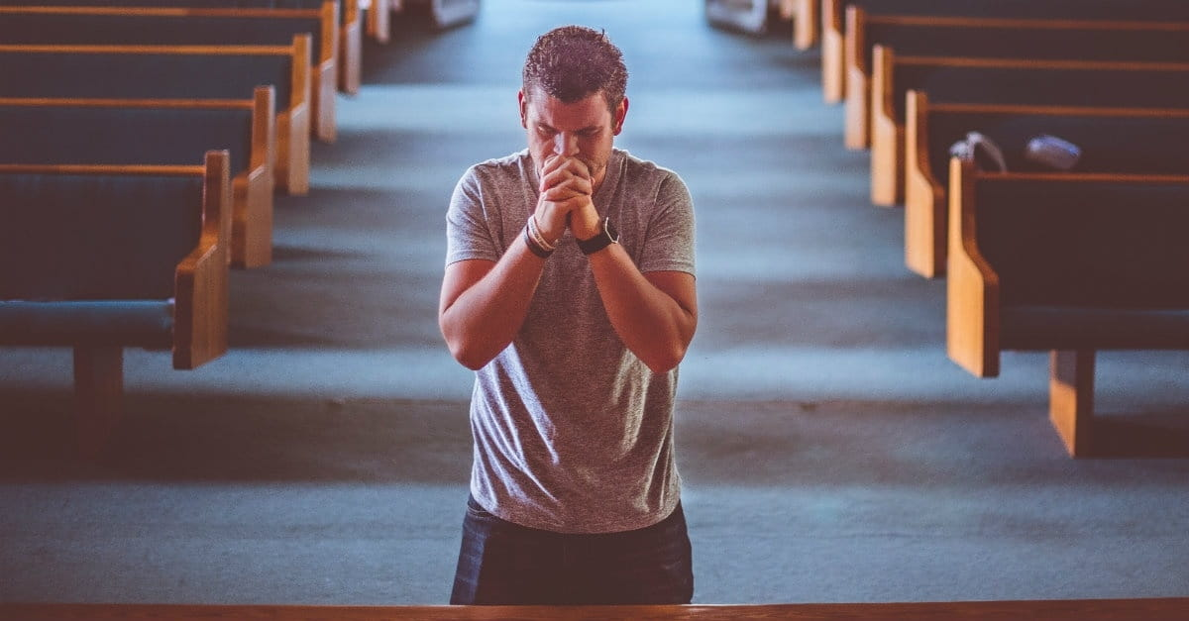
Prayer and Devotion

Slide 3
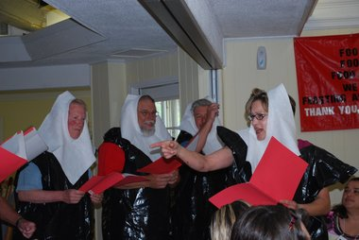
Overview
Man play a vital role in the ministry of Kairos Outside – they do so much more than skits!
They are critical to the presentation of the Kairos Outside Weekend
The men attend to the physical needs of the group and to the spiritual needs as well
Men serving on Kairos Outside teams must have a servant’s heart
Men who serve in Kairos Outside are examples of how “Men of God” should conduct themselves
Do not impose their presence on Guests, or other female team members

Slide 4
Training men to serve in Kairos Outside
Men in Kairos Outside Do…
Attend all team formation meeting, and take part
Plan menus, snacks, and prepare food for team meetings and Weekend if allowed
Decorate tables, set tables, serve meals
Prepare lists of food needed for donations and work with Agape team to solicit donations
Arrange for birthday cake for Sunday
Provide or arrange for entertainment during meals
Pray for speakers before, during and after talks
Escort Guests at Elegant Dinner
Lead Agape Service or Thanksgiving Service on Saturday night
Reset rooms as necessary
Help Agape Team as needed
Participate in team photo (back row)
Participate in Flowers At Dawn (if not in Guests’ sleeping area)
Take care of all making sure all special dietary needs are met

Slide 5
Training men to serve in Kairos Outside
Men in Kairos Outside Don’t…
Don’t go into the community room when Guests are present after 6:00 pm on Friday evening
Don’t serve the Guests and team on Friday evening
Don’t show affection to their spouse who is also serving on the Kairos Outside team
Don’t hug Guests unless they initiate it
Don’t wear cologne or after-shave lotion on Kairos Outside Weekends
Don’t have constant entertainment during meals – just one or two skits or songs

Slide 6

Time to hear from the Panel

Slide 7
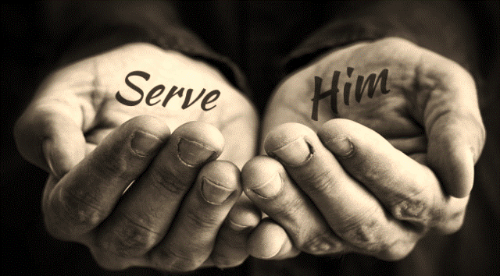

Testimonies From The Panel
What has it meant to
through

